Slide 1

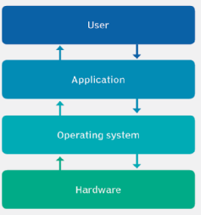
What is Linux?
Just like Windows, iOS, and Mac OS, Linux is an operating system. In fact, one of the most popular platforms on the planet, Android, is powered by the Linux operating system.
Operating System ?
An operating system is software that manages all of the hardware resources associated with your desktop or laptop.
To put it simply, the operating system manages the communication between your software and your hardware.
Without the operating system (OS), the software wouldn’t function.

Slide 2

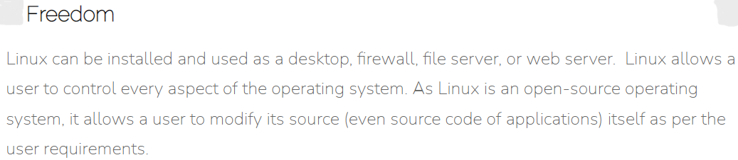
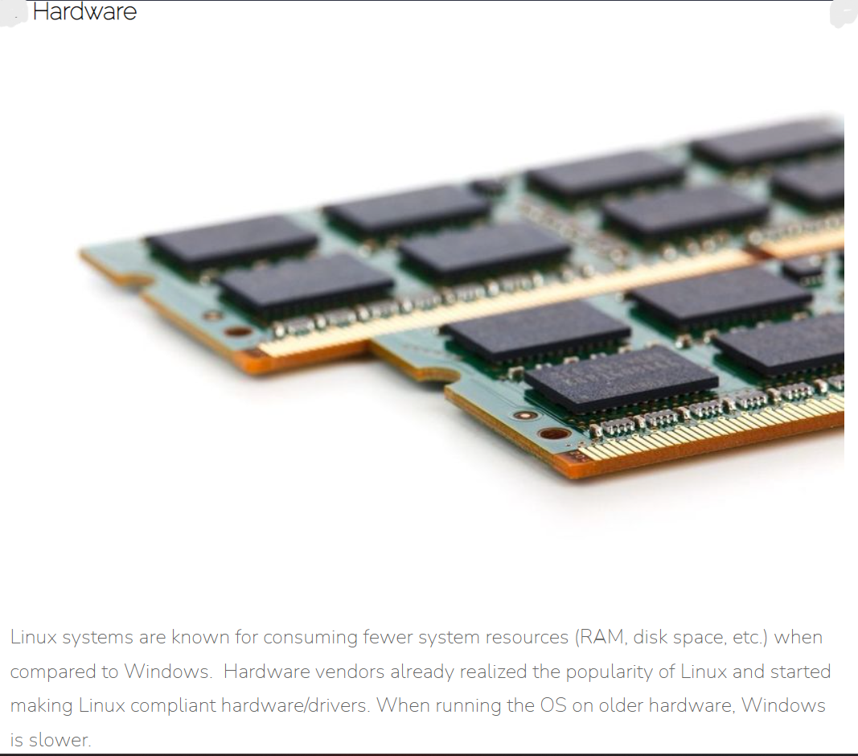
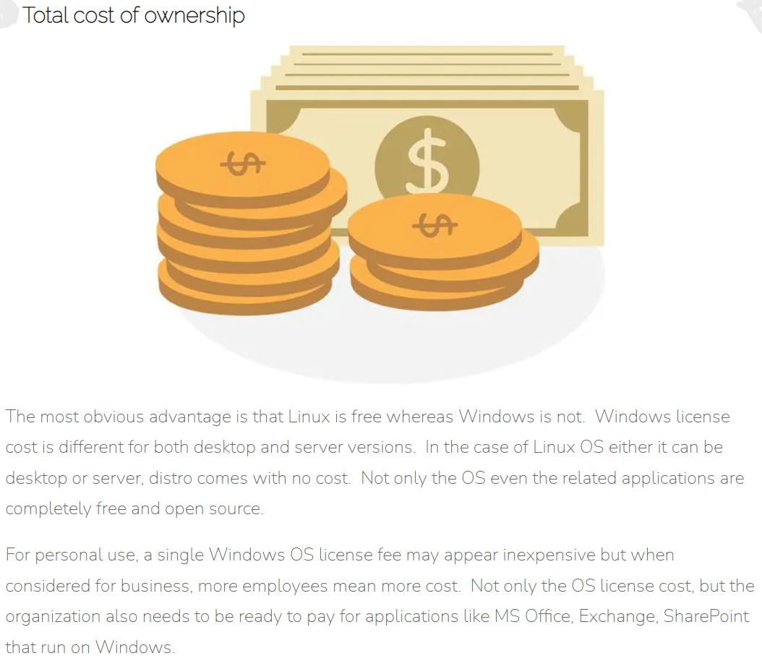

Slide 3
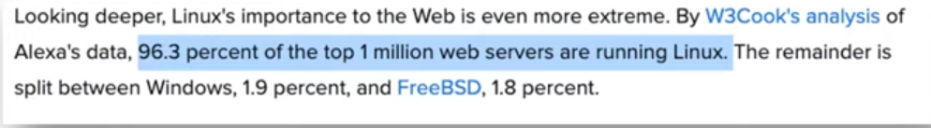
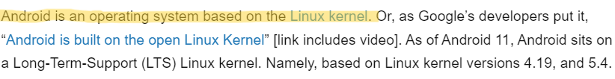
Why Linux?

Slide 4
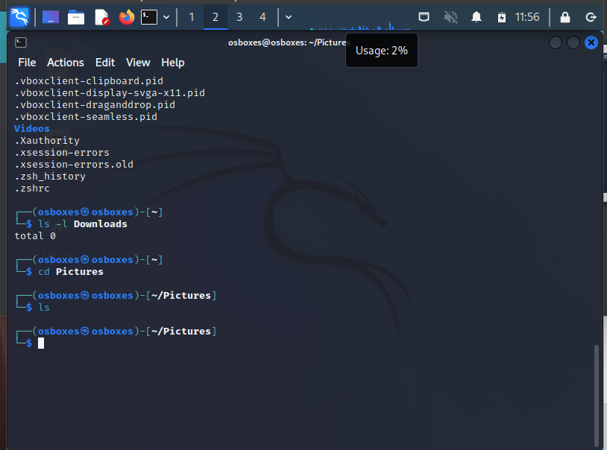
Shell
Shell in linux is a command line interface.
It is basically a software that interprets the commands that we type in the terminal
and executes it by telling the operating system what to do.
Terminal
The terminal is a program that opens a graphical window and lets us interact with the shell.

Slide 5
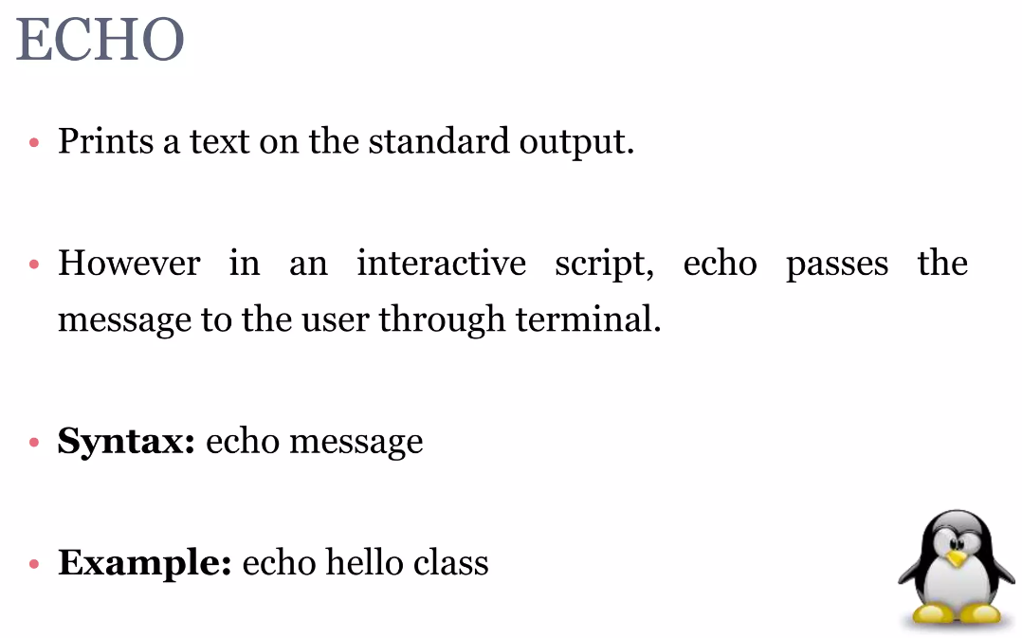

Slide 6
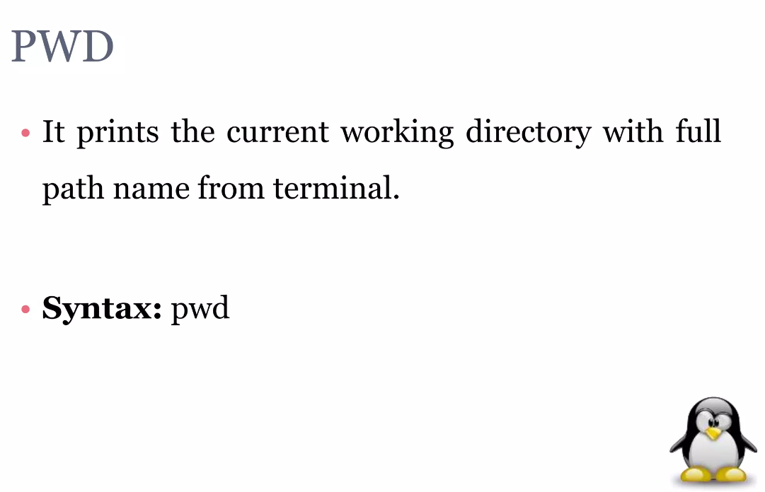

Slide 7
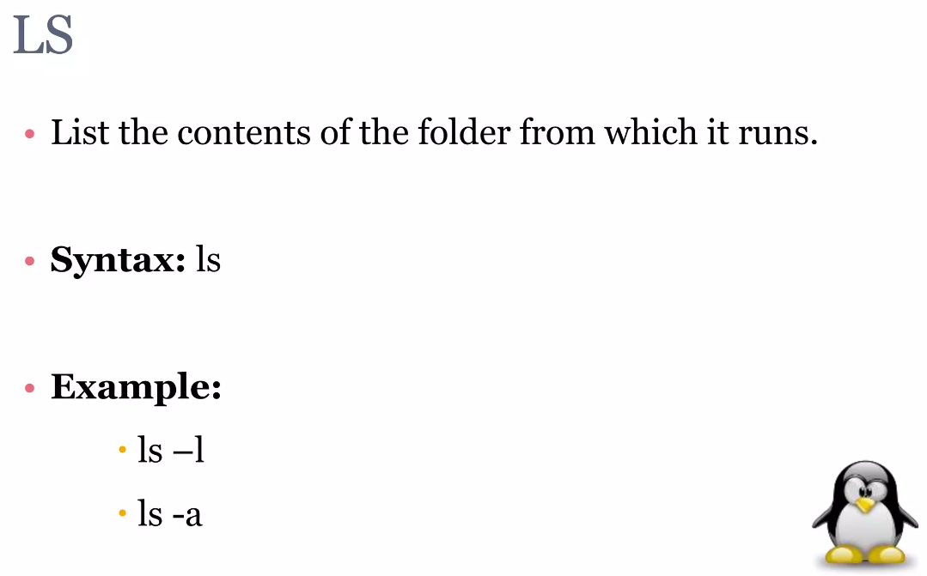
- Used to view more information about the files
- Used to list hidden files and folders

Slide 8
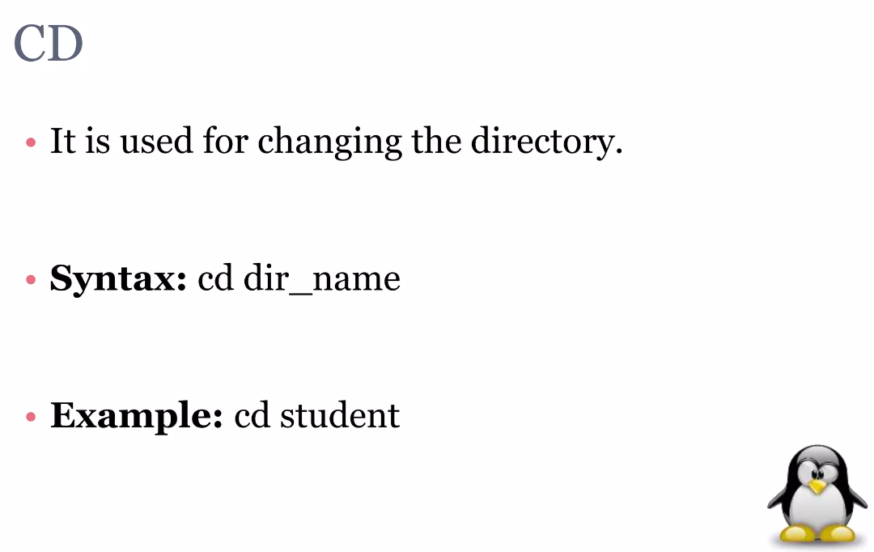

Slide 9
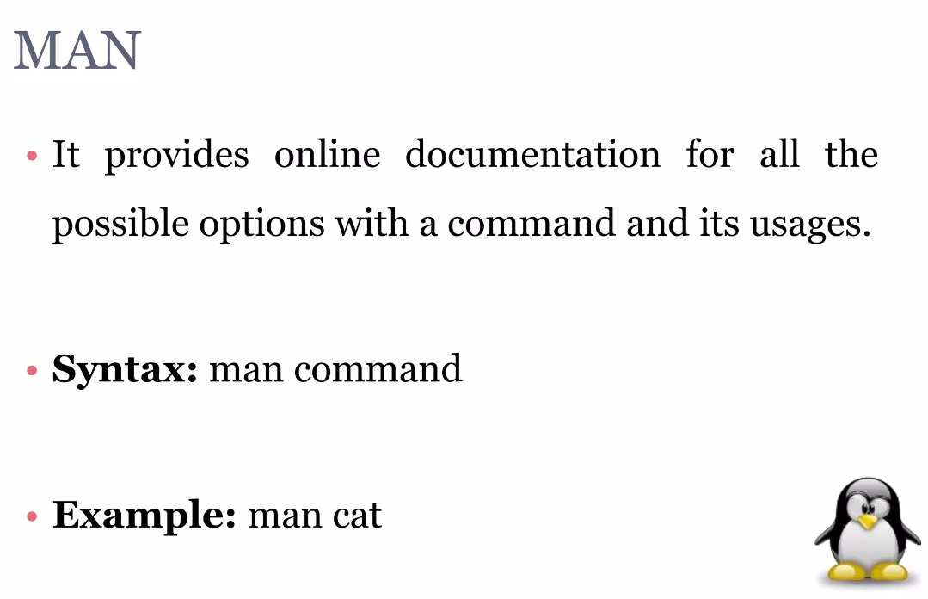

Slide 10
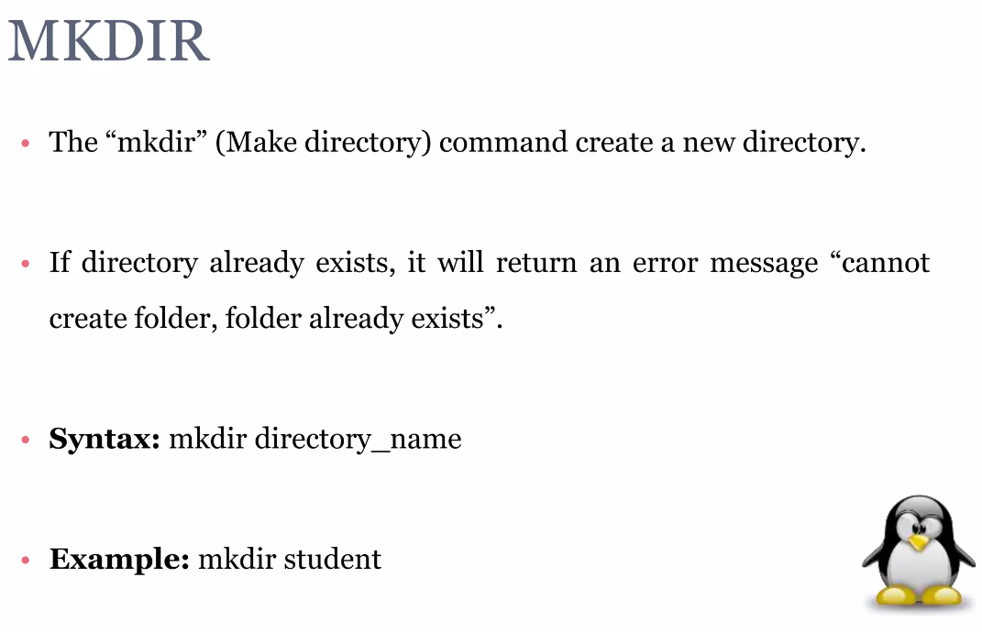

Slide 11
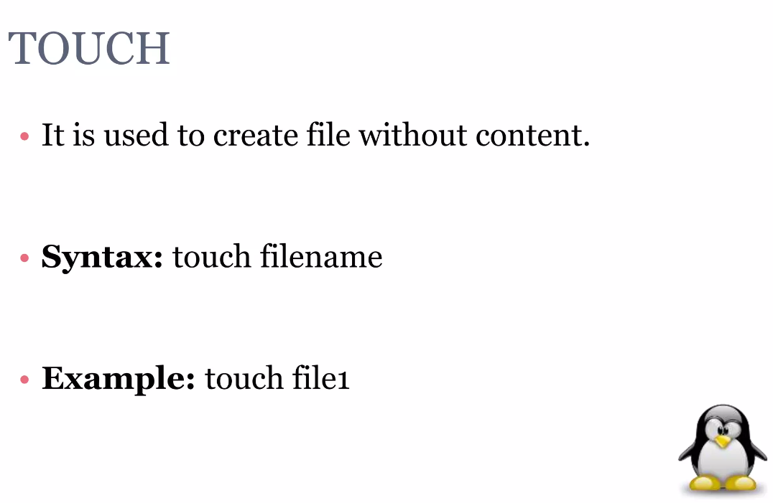

Slide 12
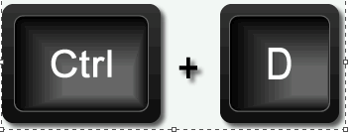

CAT >
Add contents to the file
Syntax: cat > filename
write something
To save
Example: cat > file1.txt
Hello World

Slide 13
CAT
Used to view file contents
Syntax: cat filename
Example: cat file1.txt

Slide 14
CP
Copies file content to other files
Syntax: cp file1 file2
Example: cp file1.txt file2.txt
Copies contents of file1 to file2

Slide 15

MV
Move files and directories from one location to another
Syntax: mv file/directory destination
Example: mv file.txt home

Slide 16
HEAD
Used to view the first 10 lines of files by default
No of lines displayed can be changed
Syntax: head filename
head –n filename
No of lines to be displayed
Example: head –n 4 file1.txt
First four lines will be displayed

Slide 17
TAIL
Used to view the last 10 lines of files by default
No of lines displayed can be changed
Syntax: tail filename
tail –n filename
No of lines to be displayed
Example: tail –n 4 file1.txt
First four lines will be displayed

Slide 18
FIND
Used to find files and directories and perform subsequent operations on them. It supports searching by file, folder, name, creation date, modification date, owner and permissions
Syntax: find . –type
Where to search
- represents current directory
To search for files based on types
f : regular file
d : directory
Example: find . –type f

Slide 19
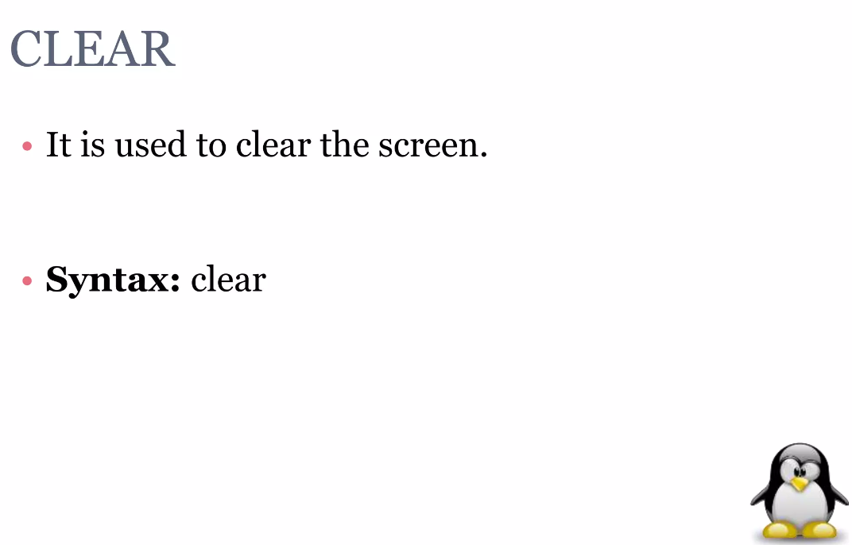

Slide 20
File Permissions
Each file or directory has three basic permission types:
Read – The Read permission refers to a user’s capability to read the contents of the file
Write – The Write permissions refer to a user’s capability to write or modify a file or _______directory
Execute – The Execute permission affects a user’s capability to execute a file or view the contents of a directory

Slide 21
ls -l
To view permissions for a file
Syntax: ls -l filename
Example: ls -l file1.txt

